Slide 1
Color Parking Lots & Evacuation Routes
Luke Norman & Pete Kandratieff

Slide 2
Color parking lots

Slide 3
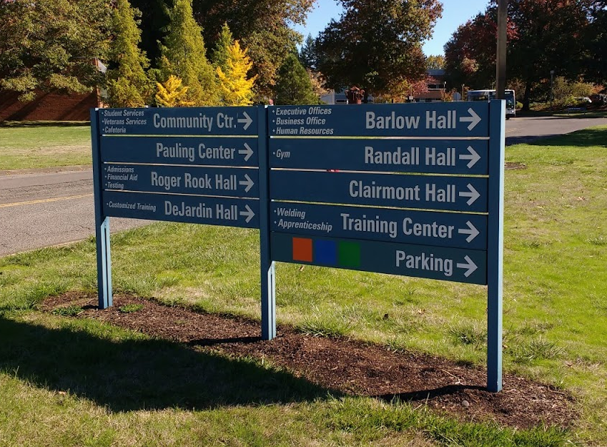
Campus Signage

Slide 4
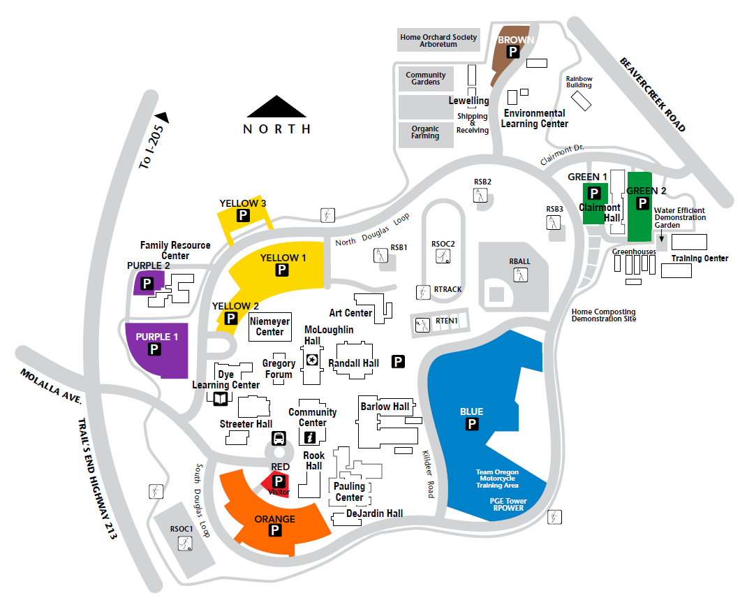
Color Parking Map

Slide 5
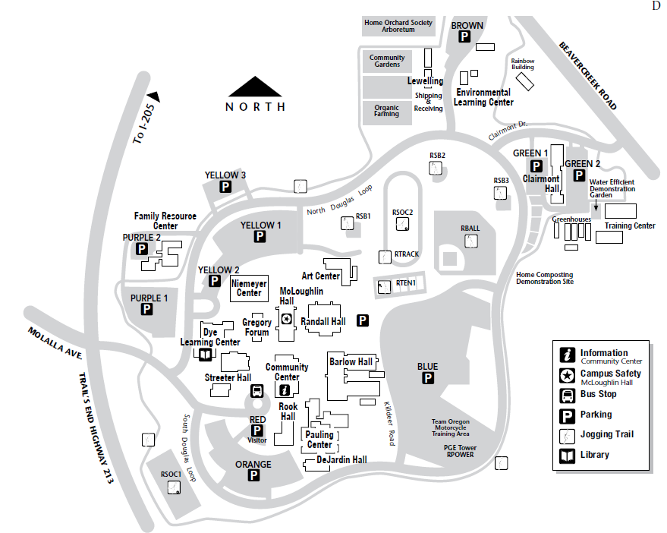
Black & White Map

Slide 6
Available Online
www.clackamas.edu/oregoncity

Slide 7
Evacuation ROUTES

Slide 8
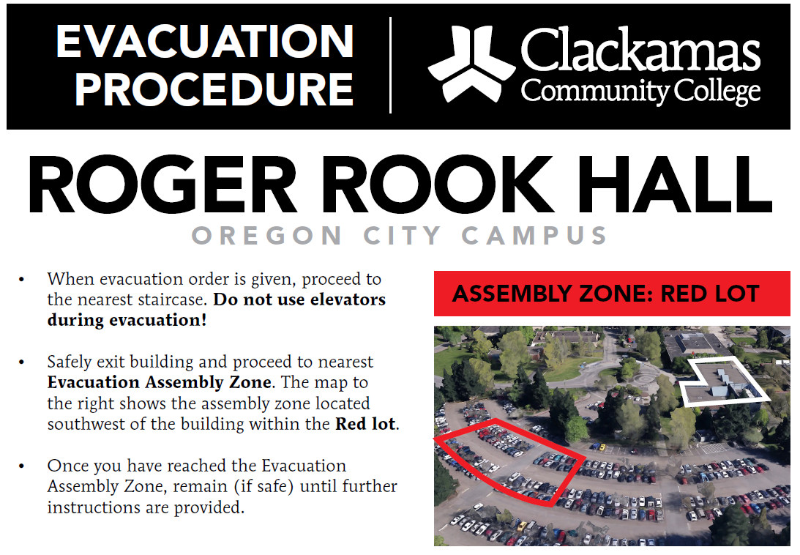
Evacuation Instructions

Slide 9
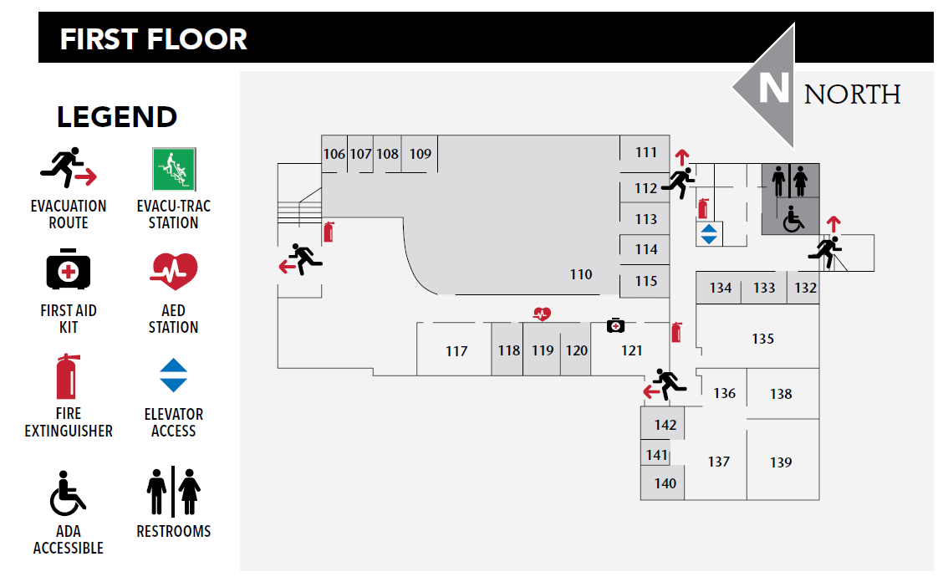
Evacuation Floor Plan

Slide 10
Questions?
Thank you

